Slide 1
Domain Model Refinement & Test-Driven Development
Lecture 11
CSCI 6628
(Covers Larman chap 13, 21, 32)

Slide 2
Lecture 11 - Objectives
Refine the domain model with generalizations, specializations, association classes, time intervals, composition, and packages.
Identify when showing a subclass is worthwhile.
To discuss when testing takes place in the life cycle
Test-driven development advocates early testing!
To cover the strategies and tools associated with object oriented testing
Analysis and Design Testing
Class Tests
Integration Tests
Validation Tests
System Tests

Slide 3
Assignment
Sprint 3 (ongoing – 3 weeks left)
Continue working prototype and report.
Yes there need to be more running / working code!

Slide 4
Domain model refinement

Slide 5
Generalization
Generalization is the activity of identifying commonality among concepts and defining superclass (general concept) and subclass (specialized concept) relationships.
It is a way to construct taxonomic classifications among concepts which are then illustrated in class hierarchies.

Slide 6
Generalization hierarchies
When to make generalization hierarchies?
Why is the following a good example?

Slide 7
Guidelines:
Identify superclasses and subclasses when they help us understand concepts in more general, abstract terms and reduce repeated information.
Expand class hierarchy relevant to the current iteration and show them in the Domain Model.

Slide 8
100% and Is-a rules
100% rule: Subclasses must conform to 100% of superclass’s attributes and associations.
Do they below?
Is-a rule (informal test): “Subclass is a Superclass”
Note, this is a different
notation to before.

Slide 9
What about this hierarchy?

Slide 10
Guidelines for creating conceptual subclasses:
Subclass has additional attributes or associations of interest
Subclass behaves or is operated on, or handled or manipulated differently than superclass or other subclasses
Based on the above criteria, it is not compelling to partition Customer into the subclasses MaleCustomer and FemaleCustomer because they have no additional attributes or associations, are not operated on (treated) differently, and do not behave differently in ways that are of interest

Slide 11
Is this hierarchy OK? What does it add to our understanding of the domain?
Models transactions with external services which are important in POS domain
Notes:
PDF see section 32.6

Slide 12
Abstract Conceptual Classes
It is useful to identify abstract classes in the domain model because they constrain what classes it is possible to have concrete instances of, thus clarifying the rules of the problem domain.
E.g., assume that every Payment instance must more specifically be an instance of the subclass CreditPayment, CashPayment, or CheckPayment. Since every Payment member is also a member of a subclass, Payment is an abstract conceptual class by definition.

Slide 13
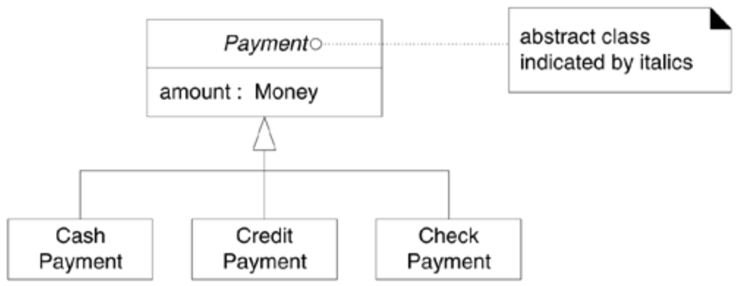

Slide 14
What about this hierarchy? (Why not?)
Classes should be invariant
Classes can maintain state information as attributes
Rather than subclasses, model changing states with state charts

Slide 15
10 min Exercise
Think about a business owner how has several companies. Each company usually employs 1 to many people. How would you model this?
Attributes I like to see:
salary
gender
company name

Slide 16
When to design Association classes?
Guideline:
In a domain model, if a class C can simultaneously have many values for the same kind of attribute A, do not place attribute A in C. Place attribute A in another class that is associated with C.
For example: A Person may have many phone numbers. Place phone number in another class, such as PhoneNumber or ContactInformation, and associate many of these to Person.
Short: Association classes allow you to add attributes, operations, and other features to associations.

Slide 17
When to design Association classes?
The fact that both Store and AuthorizationService are related to ServiceContract is a clue that it is dependent on the relationship between the two. The merchantID may be thought of as an attribute related to the association between Store and AuthorizationService.

Slide 18
When to design Association classes?
This leads to an association class, in which we can add features to the association itself. ServiceContract may be modeled as an association class related to the association between Store and AuthorizationService.
illustrated with a dashed line from the association to the association class
s

Slide 19
Guideline
Clues that an association class might be useful in a domain model:
An attribute is related to an association.
Instances of the association class have a lifetime dependency on the association.
There is a many-to-many association between two concepts and information associated with the association itself.

Slide 20
Going back to the model you created. Would you change anything based on what you just heard?

Slide 21
More Association classes

Slide 22
When to add Composition notation?
Guidelines for drawing Composition (whole-part) relationships:
Obvious whole-part physical or logical assembly
Lifetime of part is bound within lifetime of whole (create-delete dependency)
Some properties of whole propagate to parts, e.g., location
Operations of whole propagate to parts, e.g., movement
But: If in doubt, leave it out.

Slide 23
UML package diagrams
UML packages for higher level structure than classes
Denoted by box with smaller box on top
Note dependency arrows
A dependency indicates that changes to one element may cause changes to the other
Guidelines for partitioning the domain model into packages:
Place elements together if they are in same class hierarchy, participate in the same use cases, or closely related by concept or purpose, or strongly associated

Slide 24
UML package diagrams
Packages can be grouped in higher-order packages
Packages may include packages
Common package as <<global>> means all packages in system have dependency to this one
General package marked {abstract} means this package is an interface, with subtypes
Guidelines: divide classes into packages; analyze dependencies; refactor to reduce dependencies

Slide 25
Higher order package for POS domain

Slide 26
Why call this package Core for the POS domain?
Notes:
POS = Point of Sale

Slide 27
A rich package

Slide 28
Note: Composition and tie to Core package

Slide 29
Test-driven development

Slide 30
Don’t forget to plan testing!
Plan testing for classes and system
Write system and unit test plan descriptions as part of class design
Unit test all public member functions
Test for valid, invalid and boundary cases
System testing follows thorough class testing
See JUnit tool for automated test generation support

Slide 31
Object-Oriented Testing
When should testing begin?
Analysis and Design:
Testing begins by evaluating the OOA and OOD models
How do we test OOA models (requirements and use cases)?
How do we test OOD models (class and sequence diagrams)?
Structured walk-throughs, prototypes
Formal reviews of correctness, completeness and consistency
Programming:
How does OO make testing different from procedural programming?
Concept of a ‘unit’ broadens due to class encapsulation
Integration focuses on classes and their context of a use case scenario or their execution across a thread
Validation may still use conventional black box methods

Slide 32
Test-driven programming
eXtreme Programming (XP) advocates writing tests for units before writing actual code for units
Why might this practice be a good idea?
Constrains code to design: How so?
Design -> Test -> Code … in small iterations
Promotes validation and reliability: Why?
Always rerun all tests (easier with automated testing) before integrating new code in a release
Increases confidence to change code: Why?
Changes shouldn’t break old code if you can test old code
Creed of XP: “embrace change”

Slide 33
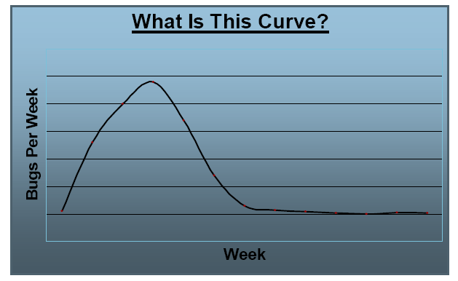
Tug Bug Curve

Slide 34
Criteria for Completion of Testing
When are we done testing? (Are we there yet?)
How to answer this question is still a research question
One view: testing is never done… the burden simply shifts from the developer to the customer
Or: testing is done when you run out of time or money
Or use a statistical model:
Assume that errors decay logarithmically with testing time
Measure the number of errors in a unit period
Fit these measurements to a logarithmic curve
Can then say: “with our experimentally valid statistical model we have done sufficient testing to say that with 95% confidence the probability of 1000 CPU hours of failure free operation is at least 0.995”

Slide 35
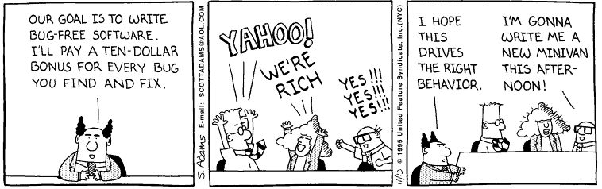
YAHOO!

Slide 36
Strategic Issues
Issues for a successful software testing strategy:
Specify product requirements long before testing commences
For example: portability, maintainability, usability Do so in a manner that is unambiguous and quantifiable
Exercise: Get together in teams of 2 and define portability, maintainability and usability in a manner that is unambiguous and quantifiable. (10 min)

Slide 37
Strategic Issues (cont’d)
Understand the users of the software, with use cases
Develop a testing plan that emphasizes “rapid cycle testing”
Get quick feedback from a series of small incremental tests
Build robust software that is designed to test itself
Use assertions, exception handling and automated testing tools (JUnit).
Conduct formal technical reviews to assess test strategy and test cases - “Who watches the watchers?”

Slide 38
Testing Analysis and Design
Syntactic correctness:
Are UML and ADT notation used correctly?
Semantic correctness:
Does the model reflect the real world problem?
Is UML used as intended by its designers?
Is the ADT design complete (capturing all the classes and operations in UML diagram) and understandable?
Testing for consistency:
An inconsistent model has representations in one part that are not reflected in other portions of the model
Notes:
ADT = Abstract Datatypes

Slide 39
Testing the Class Model
Revisit the Use Cases, CRC cards and UML class model. Check that all collaborations are properly represented. Inspect the description of each CRC index card to make sure a delegated responsibility is part of the collaborator’s definition.
Example: in a point of sale system.
A read credit card responsibility of a credit sale class is accomplished if satisfied by a credit card collaborator
Invert connections to ensure that each collaborator asked for a service is receiving requests from a reasonable source
Example: a credit card being asked for a purchase amount
Have you tested your analysis and design?
If not, who will do it?
Notes:
Class Responsibility Collaboration

Slide 40
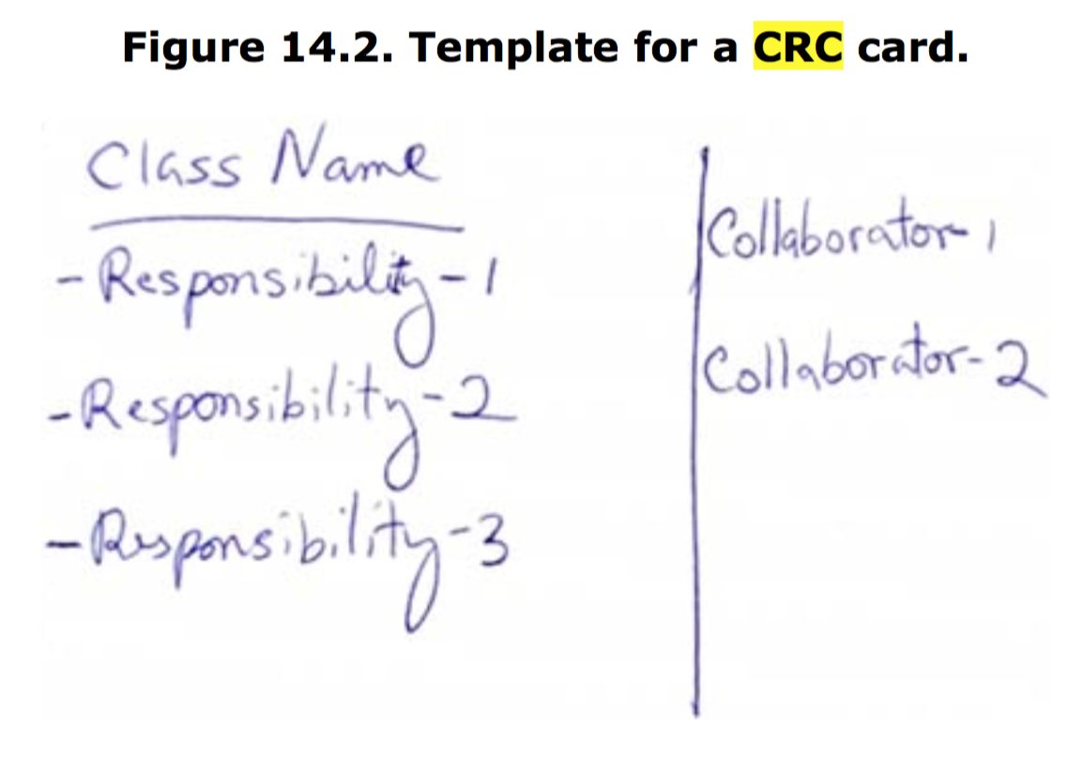
Class Responsibility Collaboration

Slide 41
Testing OO Code

Slide 42
Team exercise
We are constantly talking about testing. But what / when should we test and how do we do it?
~10 min.

Slide 43
Testing OO Code
Class tests
Integration
tests
System
tests
Validation
tests

Slide 44
[1] Class (Unit) Testing
Smallest testable unit is the encapsulated class
Test each operation as part of a class hierarchy because its class hierarchy defines its context of use
Approach:
Test each method (and constructor) within a class
Test the state behavior (attributes) of the class between methods
How is class testing different from conventional testing?
Conventional testing focuses on input-process-output, whereas class testing focuses on each method, then designing sequences of methods to exercise states of a class

Slide 45
Class Testing Process
How to test?
class
to be
tested
results
software
engineer
test cases
Why a loop?

Slide 46
Class Test Case Design
Identify each test case uniquely
Associate test case explicitly with the class and/or method to be tested
State the purpose of the test
Each test case should contain:
A list of messages and operations that will be exercised as a consequence of the test
A list of exceptions that may occur as the object is tested
A list of external conditions for setup (i.e., changes in the environment external to the software that must exist in order to properly conduct the test)
Supplementary information that will aid in understanding or implementing the test
Automated unit testing tools facilitate these requirements

Slide 47
Challenges of Class Testing
Encapsulation:
Difficult to obtain a snapshot of a class without building extra methods which display the classes’ state
Inheritance and polymorphism:
Each new context of use (subclass) requires re-testing because a method may be implemented differently (polymorphism).
Other unaltered methods within the subclass may use the redefined method and need to be tested
White box tests:
Basis path, condition, data flow and loop tests can all apply to individual methods, but don’t test interactions between methods
Notes:
Als Kapselung bezeichnet man den kontrollierten Zugriff auf Methoden bzw. Attribute von Klassen. Klassen können den internen Zustand anderer Klassen nicht in unerwarteter Weise lesen oder ändern.

Slide 48
Random Class Testing
Identify methods applicable to a class
Define constraints on their use – e.g. the class must always be initialized first
Identify a minimum test sequence – an operation sequence that defines the minimum life history of the class
Generate a variety of random (but valid) test sequences – this exercises more complex class instance life histories
Example:
An account class in a banking application has open, setup, deposit, withdraw, balance, summarize and close methods
The account must be opened first and closed on completion
Open – setup – deposit – withdraw – close
Open – setup – deposit –* [deposit | withdraw | balance | summarize] – withdraw – close. Generate random test sequences using this template

Slide 49
[2] Integration Testing
A typical software project consists of multiple software modules, coded by different programmers.
Integration testing focuses on checking data communication amongst these modules.
Individual software modules are integrated logically and tested as a group.
Notes:
Der Begriff Integrationstest bezeichnet in der Softwareentwicklung eine aufeinander abgestimmte Reihe von Einzeltests, die dazu dienen, verschiedene voneinander abhängige Komponenten eines komplexen Systems im Zusammenspiel miteinander zu testen. Die erstmals im gemeinsamen Kontext zu testenden Komponenten haben im Idealfall jeweilige Modultests erfolgreich bestanden und sind für sich isoliert fehlerfrei funktionsfähig.

Slide 50
[2] Integration Testing
Unit test: Specify and test one point of the contract of single method of a class. This should have a very narrow and well defined scope.
Integration test: Test the correct inter-operation of multiple subsystems. There is whole spectrum there, from testing integration between two classes, to testing integration with the production environment.
Notes:
Der Begriff Integrationstest bezeichnet in der Softwareentwicklung eine aufeinander abgestimmte Reihe von Einzeltests, die dazu dienen, verschiedene voneinander abhängige Komponenten eines komplexen Systems im Zusammenspiel miteinander zu testen. Die erstmals im gemeinsamen Kontext zu testenden Komponenten haben im Idealfall jeweilige Modultests erfolgreich bestanden und sind für sich isoliert fehlerfrei funktionsfähig.

Slide 51
Integration Testing Strategies
OO does not have a hierarchical control structure so conventional top-down and bottom-up integration tests have little meaning
Integration applied different incremental strategies, e.g.,:
Thread-based testing:
testing all classes required to respond to one system input or event
Use-based testing:
integrates classes required by one use case
Cluster testing:
integrates classes required to demonstrate one collaboration
Notes:
Der Begriff Integrationstest bezeichnet in der Softwareentwicklung eine aufeinander abgestimmte Reihe von Einzeltests, die dazu dienen, verschiedene voneinander abhängige Komponenten eines komplexen Systems im Zusammenspiel miteinander zu testen. Die erstmals im gemeinsamen Kontext zu testenden Komponenten haben im Idealfall jeweilige Modultests erfolgreich bestanden und sind für sich isoliert fehlerfrei funktionsfähig.
http://www.guru99.com/thread-testing.html

Slide 52
Challenges
Can be very complex especially if multi-threading is involved.
One challenge with integration testing is when multiple teams are developing code.
There are no stories or tasks assigned and so it's unclear who is responsible for the integration testing that must happen to ensure the code deployed by different teams is working well together.
And for fixing.

Slide 53
Random Integration Testing
Multiple Class Random Testing
For each client class, use the list of class methods to generate a series of random test sequences. Methods will send messages to other server classes.
For each message that is generated, determine the collaborating class and the corresponding method in the server object.
For each method in the server object (that has been invoked by messages sent from the client object), determine the messages that it transmits
For each of the messages, determine the next level of methods that are invoked and incorporate these into the test sequence

Slide 54
[3] Validation Testing
Determining if the system complies with the requirements and performs functions for which it is intended and meets the organization’s goals and user needs.
Validation is done at the end of the development process and takes place after verifications are completed.
It answers the question like: Am I building the right product?

Slide 55
Validation Testing (cont’d)
Validation succeeds when software functions in a manner that can be reasonably expected by the customer.
Focus on user-visible actions and user-recognizable outputs
Details of class connections disappear at this level
Apply:
Use-case scenarios from the software requirements specification
Black-box testing to create a deficiency list
Acceptance tests through alpha (at developer’s site) and beta (at customer’s site) testing with actual customers
Is it possible that a software passes Class and Integration test but fail Validation testing? If so, example.
How will you validate your term product?

Slide 56
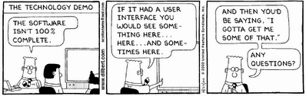
Acceptance testing, anyone?

Slide 57
[4] System Testing
Software may be part of a larger system. This often leads to “finger pointing” by other system dev teams
Finger pointing defense:
Design error-handling paths that test all info coming from other elements of the system
Conduct a series of tests that simulate bad data or other potential errors at the interface
Record the results of tests to use as evidence (if finger pointing occurs)

Slide 58
System Testing vs. Validation Testing
Validation testing to test software if it meets its stated requirements.
System testing is the testing of the Software and Hardware together and to find out if they both can work together to be a successful application.

Slide 59
Types of System Testing
Recovery testing:
how well and quickly does the system recover from faults
Security testing:
verify that protection mechanisms built into the system will protect from unauthorized access (hackers, disgruntled employees, fraudsters)
Stress testing:
place abnormal load on the system
Performance testing:
investigate the run-time performance within the context of an integrated system

Slide 60
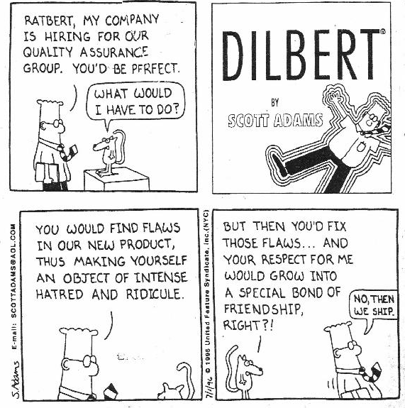
Can we do better?

Slide 61
Testing Summary
Testing affects all stages of software engineering cycle
One strategy is a bottom-up approach – class, integration, validation and system level testing
XP advocates test-driven development: plan tests before you write any code, then test any changes
Other techniques:
white box (look into technical internal details)
black box (view the external behavior)
debugging (systematic cause elimination approach is best)
analysis
design
code
test

